Slide 1
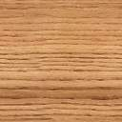



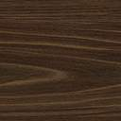
The Wooden Man P_{interactive} Winning Computer
ersonally
Leeds / PwC Apprentice Team
David Marples & Calum Wallbridge

Slide 2
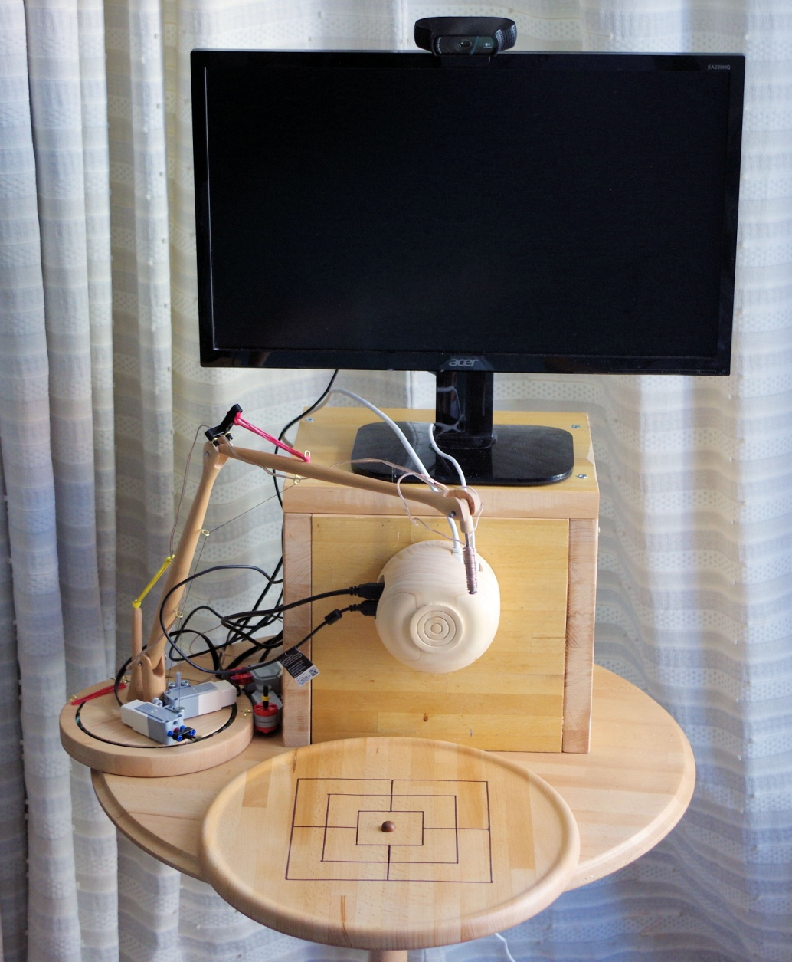
The Wooden Man

Slide 3
Project Elements
Aim: To create a robot capable of playing a range of board games using counters: initially Tic-Tac-Toe, Nine Mens Morris, and Draughts.
This requires:
Vision system
Robotic arm
AI players for games
“Operating System”

Slide 4
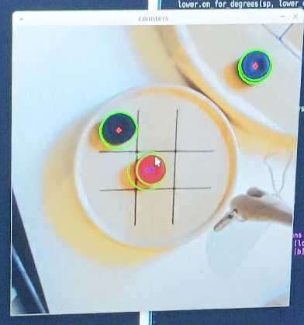
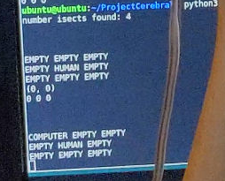
Vision System
Single webcam – monocular.
Viewing scene obliquely, so need to:
Rectify image
Identify board (and so game)
Identify objects of interest (e.g. Counters)

Slide 5
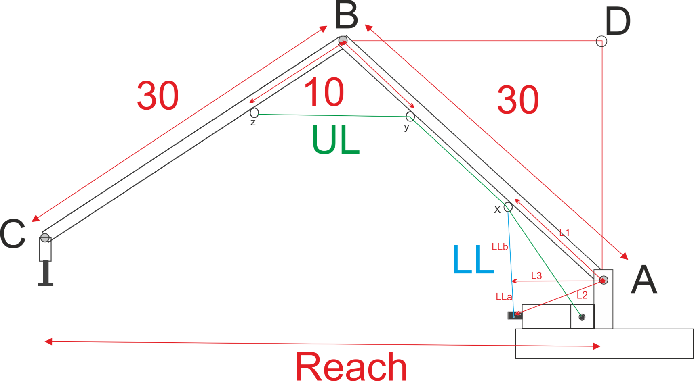
Robot Arm

